Slide 1
QuickSort

Slide 2
Quicksort
Based on the idea that it is faster to sort two small lists than one larger list
Name comes from the fact that, in general, quick sort can sort a list of data elements quite quickly.
Divide and Conquer
Data moved over large distances in the early stages of a sort => efficient sorting algorithm.

Slide 3
Example: A bundle of final exam papers to sort by name.
Pick a splitting value say L
Divide the bundle into two bundles, one containing names A-L, the other containing names M-Z
Now take the first bundle and again subdivide it into two, A-F and G-L
Repeat again with the A-F bundle giving A-C and D-E
Continue until all the bundles are small enough to be easily sorted.
Apply the same process to the M-Z bundle.
Eventually all the small sorted bundles can be placed one on top of the other to produce the sorted set of tests.

Slide 4
Based on RECURSION.
Divided in two based on some splitting value
Same approach applied to the two smaller cases
Continues until the case is small enough that it does not require further division (Base Case)
Now consider the following example:
Sort the following array of elements using the Quick Sort method:
20 35 18 8 14 41 3 39

Slide 5
For the moment, GUESS at the split value, that allows us to divide the array s.t. all the BIG elements are in the RH end of the array and all the small values in the LH end.
Segment of all
SMALL elements
Segment of all
LARGE elements
So, choose 18 as the split value, and split the array, allowing values equal to 18 in both segments.

Slide 6
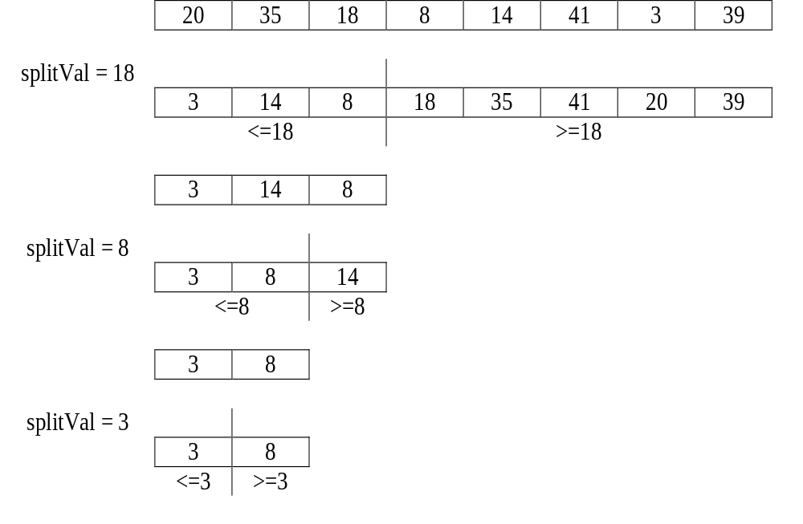

Slide 7
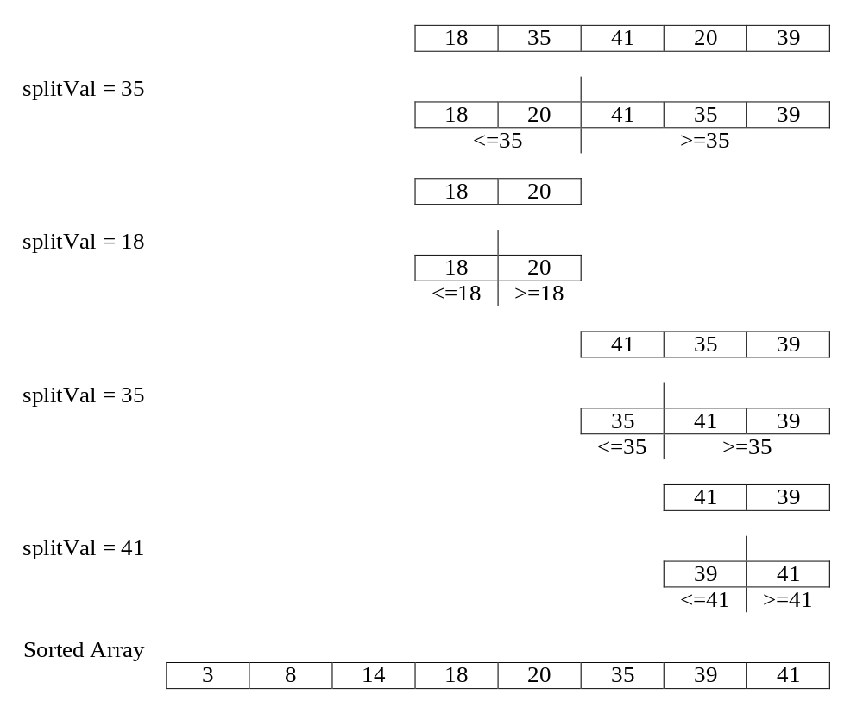

Slide 8
Quick Sort can be implemented recursively.
The parameter list of the QuickSort function reflects the part of the list that is currently being processed: we pass the array and the first and last indexes that define the part of the array to be processed on this call.
The initial call to QuickSort is
QuickSort (Values, 0, numberOfValues-1);

Slide 9
Function QuickSort()
Definition: Sorts the items in array values.
Size: values[first].. values[last]
Base Case: If less than 2 items in values[first] .. values[last], do nothing.
General Case: Split the array according to splitting value.
QuickSort the elements <= splitting value.
QuickSort the elements >= splitting value.

Slide 10
QuickSort()
if there is more than one item in values[first] .. values[last]
select splitVal
split the array so that
values[first] .. values[splitPoint] <= splitVal
values[splitPoint+1].. values[last] >= splitVal
QuickSort the left half
QuickSort the right half

Slide 11
Selecting the Split Value splitVal
"Guessing" a random value should on average (if the data is random) give as good a result as any.
The simplest strategy may be to always select the first value in the partition.
This is a poor choice if the data is already sorted or in reverse order.
The best way to accommodate these cases without it effecting the general case is to choose the value in the middle of the partition:
splitVal = values[(first + last)/2]

Slide 12
Recursive QuickSort() Our first attempt, based on the previous example!
void QuickSort (ItemType values[], int first, int last)
{
int splitPoint;
if (first < last)
{
Split (values, first, last, splitPoint);
//values[first]..values[splitPoint]<= splitVal
//values[splitPoint+1]..values[last]>= splitVal
QuickSort(values, first, splitPoint);
QuickSort(values,splitPoint+1, last);
}
}

Slide 13
Three Question Method of Verification:
1. Is there a nonrecursive base case?
Yes. When first >= last (there is at most one element in the segment), QuickSort does nothing.

Slide 14
2. Does each recursive call involve a smaller case of the problem?
Yes. Split() divides the segment into two not necessarily equal pieces, and each of these smaller pieces is then QuickSort()'d. Note that even if splitVal is the largest or smallest value in the segment, the two pieces are still smaller than the original one:
if splitVal is smaller than all the other values in the segement, then QuickSort(values, first, splitPoint) terminates immediately because first = splitPoint.
QuickSort(values, splitPoint+1, last) quick sorts a segment one element smaller than the original.

Slide 15
3. Assuming that the recursive calls succeed, does the whole function work?
Yes. We assume that
QuickSort(values, first, splitPoint)
actually sorts the first splitPoint elements, whose values are less than or equal to splitVal.
We also assume that
QuickSort(values, splitPoint+1, last)
has correctly sorted the rest of the list, whose values are all greater than or equal to splitVal. So we know that the whole list is sorted.

Slide 16
Function Split()
The following is the function call to Split() in the QuickSort() function:
Split (values, first, last, splitPoint);
The array values will get altered during Split() and therefore values must correspond to a reference parameter.
Remember that arrays are always called by reference anyway!

Slide 17
The arguments first and last are passing information into the function and therefore correspond to value parameters.
However splitPoint is passed back to QuickSort() and must correspond to a reference parameter.
Therefore, Split() has the following function prototype:
Split (ItemType values[],int first, int last,
int& splitPoint);
Consider the follow example again:

Slide 18
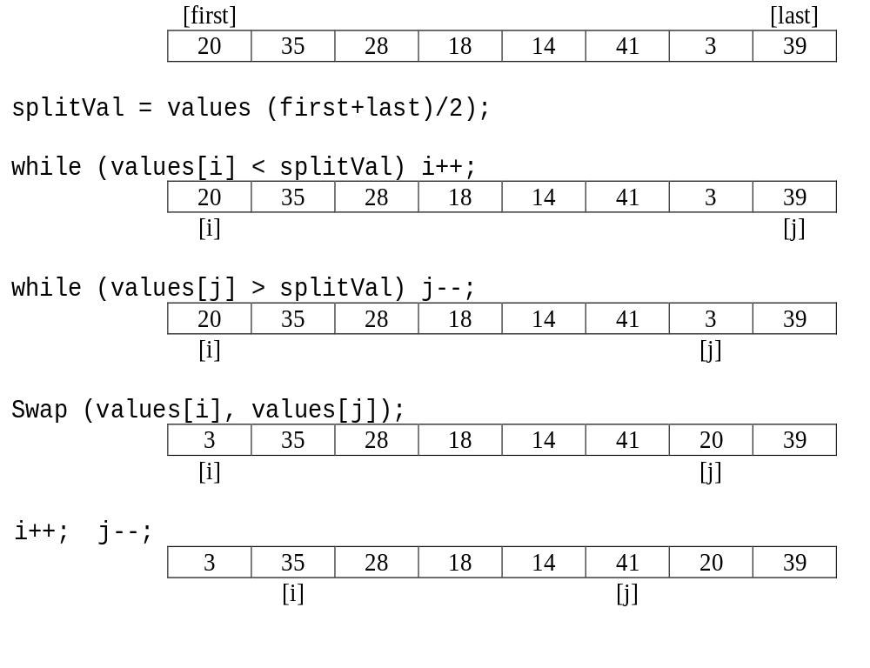

Slide 19
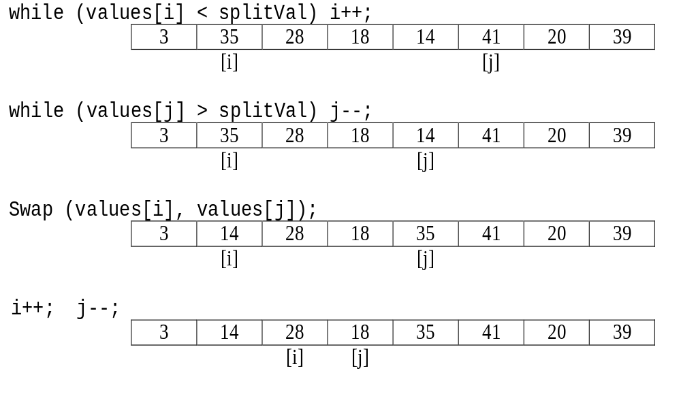

Slide 20
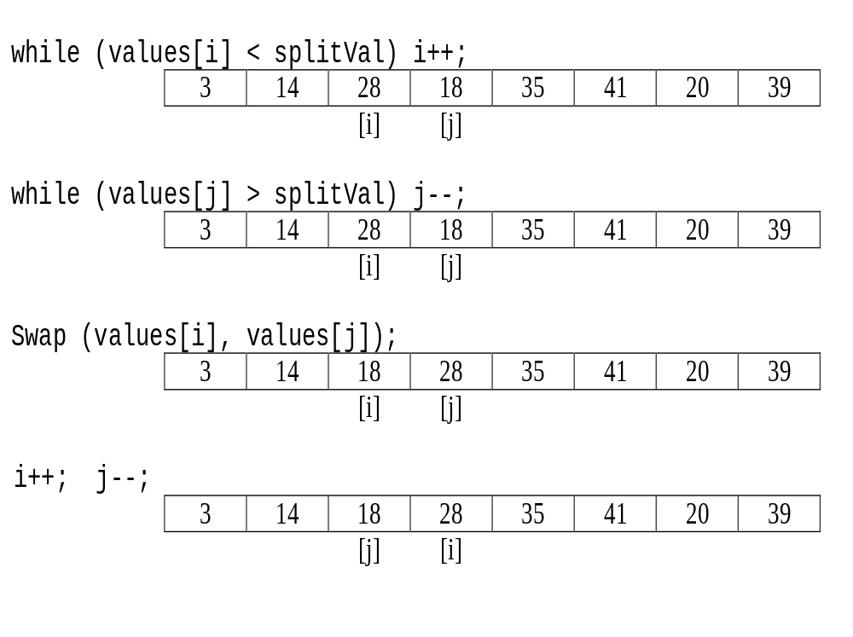

Slide 21
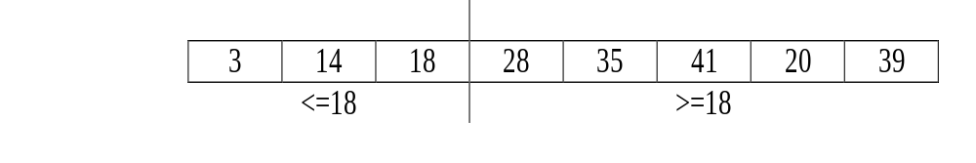
At this stage, i and j have crossed over and the array is divided into the two segments, with all the elements <= 18 in the LH segment, and those >= 18 in the RH segment
splitPoint = j
NOTE: The splitting process must finish once i and j cross over. Therefore before an exchange is made, a check must be made to make sure i and j have not crossed over.

Slide 22
Algorithm:
Initialize splitVal to the middle value in the array segment values[first].. values[last].
Initialize i = first, j= last
Find the first pair of elements that need to be swapped, moving i and j inward towards the middle.
While i is less than j (i.e the two segments have not crossed over)
  swap values[i] and values[j]
  increment i and decrement j
  Find the next pair of elements that need to be swapped, moving i and j inward towards the middle.
Assign splitPoint = j

Slide 23
This implies the following code:
splitVal = values[(first+last)/2];
i = first; j = last;
while (values[i] < splitVal) i++;
while (values[j] > splitVal) j--;
while (i < j)
{
t = values[i]; values[i] = values[j]; values[j] = t;
i++; j--;
while (values[i] < splitVal) i++;
while (values[j] > splitVal) j--;
}
splitPoint = j;

Slide 24
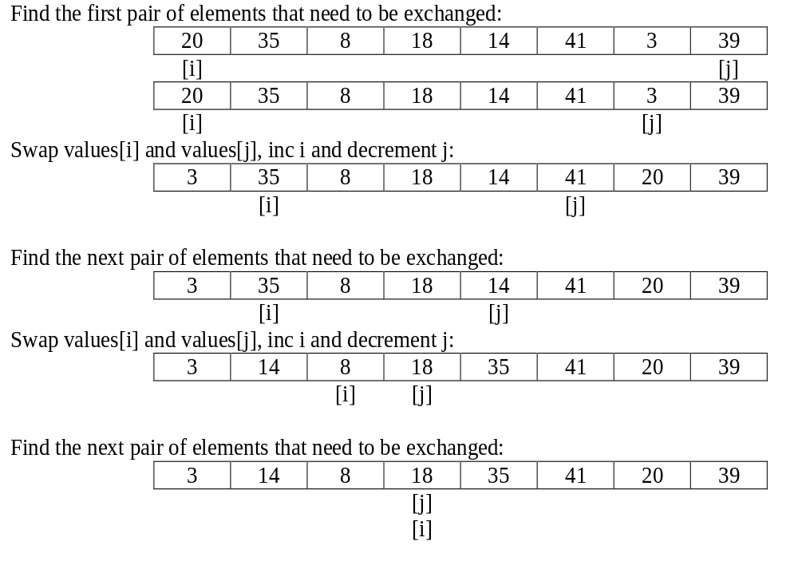
Now consider the following example:

Slide 25
This time the two segments meet rather than crossover. When this occurs, we know that
values[first]..values[i-1] are <= splitVal
values[j+1]..values[last] are >= splitVal
values[i] must be >= splitVal
values[j] must be <= splitVal
But since i = j, values[i] = values[j] and therefore must be = splitVal
Therefore, values[i] = values[j] = splitVal => this value must be in its correct sorted position, and can therefore be excluded from further processing.

Slide 26
This gives rise to the following modification to our algorithm:
Algorithm:
Initialize splitVal to the middle value in the array segment values[first].. values[last].
Initialize i = first, j= last
Find the first pair of elements that need to be swapped, moving i and j inward towards the middle.

Slide 27
While i is less than j (i.e the two segments have not met or crossed over)
  swap values[i] and values[j]
  increment i and decrement j
  Find the next pair of elements that need to be swapped, moving i and j inward towards the middle.
If i is equal to j then
  increment i and decrement j
Assign splitPt1 = i
Assign splitPt2 = j

Slide 28
C++ Code:
splitVal = values[(first+last)/2];
i = first; j = last;
while (values[i] < splitVal) i++;
while (values[j] > splitVal) j--;
while (i < j)
{
t = values[i]; values[i] = values[j]; values[j] = t;
i++; j--;
while (values[i] < splitVal) i++;
while (values[j] > splitVal) j--;
}

Slide 29
if (i == j)
{
i++; j--;
}
splitPt1 = i;
splitPt2 = j;
A modification to the function prototype for Split() is required and also the calling statement in function QuickSort() calling Split()

Slide 30
Putting it all together gives the following:
void Split(ItemType values[],
int first, int last,
int& splitPt1,
int& splitPt2);

Slide 31
void QuickSort (ItemType values[], int first, int last)
{
int splitPt1, splitPt2;
if (first < last)
{
Split(values, first, last, splitPt1, splitPt2);
//values[first]..values[splitPt2]<= splitVal
//values[splitPt1]..values[last]>= splitVal
QuickSort(values, first, splitPt2);
QuickSort(values, splitPt1, last);
}
}

Slide 32
void Split(ItemType values[],
int first, int last,
int& splitPt1, int& splitPt2)
{
Itemtype splitVal = values[(first+last)/2],t;
int i = first, j = last;
while (values[i] < splitVal) i++;
while (values[j] > splitVal) j--;

Slide 33
while (i < j)
{
t = values[i]; values[i] = values[j];
values[j] = t;
i++; j--;
while (values[i] < splitVal) i++;
while (values[j] > splitVal) j--;
}
if (i == j)
{
i++; j--;
}
splitPt1 = i;
splitPt2 = j;
}

